Slide 1

SAP Cloud Platform ABAP Environment
Product Management SAP Cloud Platform
2018

Slide 3
TABLE OF CONTENTS
WHY SAP Cloud Platform?
WHY ABAP in SAP Cloud Platform?
SCENARIOS for SAP Cloud Platform ABAP Environment
ROADMAP for SAP Cloud Platform ABAP Environment

Slide 4
Why SAP Cloud Platform?

Slide 5
Managing your digital transformation with SAP’s Digital Enterprise Platform
AGILE LAYER Differentiate Your Business
SAP SOLUTIONS
SAP CLOUD PLATFORM
Digital
Transformation
NEW
DIGITAL CORE Optimize Your Core Processes
Agile
Business
Optimized
Enterprise
DATA AS YOUR FOUNDATION

Slide 6

Extensibility with SAP Cloud Platform
INNOVATIONS
Benefit from SAP HANA, SAP S/4HANA and SAP Cloud Platform innovations
DE-COUPLING
Side-by-side approach adds flexibility for upgrades and custom / partner driven innovation
DEVELOPMENT PRODUCTIVITY
High development productivity based on tools, re-use of business services and first class integration with SAP solutions
AGILITY & RELEASE STRATEGY
Start today on SAP Cloud Platform and connect to multiple backend releases

Slide 7











When to use what?
Your developers skillset
Your software assets
Your scenarios and use-cases
DECISION CRITERIA
ABAP
Java
Node.js and HTML5
BYOL
ABAP
Java and the Java logo are registered trademarks of Oracle and/or its affiliates.

Slide 8
Why ABAP in SAP Cloud Platform?

Slide 9



Motivation
Customer Base
Enterprise Readiness
Transition to Cloud
Huge customer and partner base running ABAP based solutions with custom code
ABAP as proven environment for enterprise ready business applications with competitive cost of development
Growing market adoption of SAP S/4HANA Cloud with
tailored extensibility for customers and partners

Slide 10



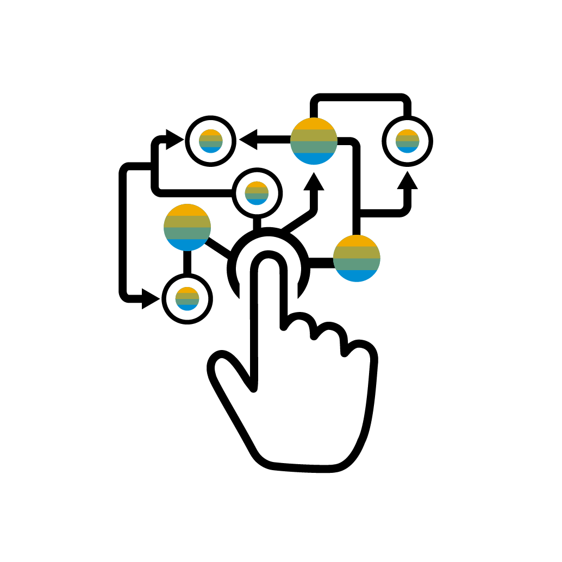
WHY ABAP IN SAP CLOUD PLATFORM?
TRANSFORMATION TO CLOUD
MARKET OPPORTUNITIES FOR PARTNERS
AGILE INNOVATION ON NEWEST TECHNOLOGY POWERED BY SAP HANA
DELEGATE INFRASTRUCTURE AND SYSTEM OPERATIONS

Slide 11
SAP CLOUD PLATFORM ABAP ENVIRONMENT MAIN USE CASES
TRANSFORMATION TO CLOUD
MARKET OPPORTUNITIES FOR PARTNERS
Develop ABAP cloud apps decoupled from the digital core
Leverage your ABAP know how in the cloud
Reuse your existing ABAP assets
Commercialize your apps via SAP Cloud Platform
Benefit from large SAP customer base
Network with ABAP community

Slide 12
AGILE INNOVATION ON NEWEST TECHNOLOGY POWERED BY SAP HANA
DELEGATE INFRASTRUCTURE AND SYSTEM OPERATIONS
Benefit from newest ABAP Programming Model
Exploit SAP HANA capabilities
Consume SAP Cloud Platform services like SAP Leonardo
SAP CLOUD PLATFORM ABAP ENVIRONMENT MAIN USE CASES
Regular delivery of innovations by SAP
Scale with your business needs
Support for multiple cloud providers Pay per use

Slide 13
Vital parts of SAP Cloud Platform ABAP Environment
SAP CLOUD PLATFORM
CLOUD COCKPIT
ABAP PLATFORM AS A SERVICE
BACKEND SYSTEM
e.g. SAP S/4HANA Cloud, SAP S/4HANA, SAP ERP, SAP NetWeaver AS ABAP
ABAP DEVELOPMENT TOOLS IN ECLIPSE
HTTP SERVICES AND NEW RESTful ABAP PROGRAMMING MODEL utilizing
SAP Fiori
Core Data Services
Cloud optimized ABAP language
SERVICES ECOSYSTEM
User Management
IoT
…
EXTERNAL HTTP SERVICE
GIT CODE MANAGEMENT
SAP HANA

Slide 14
Scenarios for SAP Cloud Platform ABAP Environment

Slide 15




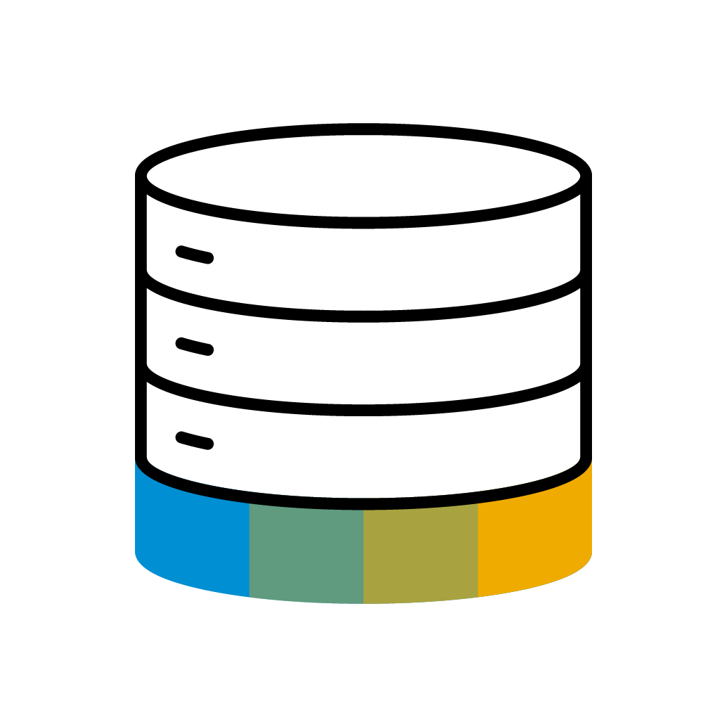

Side-by-side Extensibility for SAP S/4HANA Cloud
SAP CLOUD PLATFORM
Your ABAP extension
SAP S/4HANA CLOUD
OData
Application Clients
Connectivity
Custom Data SAP HANA tenant
Corporate Identity Provider

Slide 16


Partner side-by-side apps (SaaS scenario)
Partner
SAP CLOUD PLATFORM
commercialization
SAP S/4HANA CLOUD
Your ABAP extension
deployment
Connectivity
Custom Data SAP HANA tenant
SAP App Center

Slide 17




Transformation of existing custom code to SAP Cloud Platform ABAP Environment
DECOUPLE CUSTOM CODE FROM SAP APPLICATION CODE
Always read and write from backend system via remote interfaces
Adapt to whitelisted APIs
USE SAP CLOUD PLATFORM SERVICES
e.g. integration service, attachment service
ADOPT NEW RESTful ABAP PROGRAMMING MODEL
Including SAP HANA, Core Data Services and SAP Fiori
MANAGE DEVELOPMENT PROCESS AND DEPLOYMENT
Use Git and continous integration
UTILIZE PARTNER ECOSYSTEM
SAP Cloud Platform offers commercialization infrastructure for partners
ELIMINATE USE OF DEPRECATED ABAP FUNCTIONALITY

Slide 18
Roadmap for SAP Cloud Platform ABAP Environment

Slide 19

Roadmap
2018
2019
General availability for customers and partners with the scenarios
Develop and run extensions for SAP S/4HANA cloud
Support custom code transformation to SAP Cloud Platform
SAP Fiori & RESTful ABAP programming model
Whitelisted APIs
Cloud optimized ABAP language
Git integration
Additional support for partners
Productizing model for partners
Integration with SAP App Center

Slide 20
Thank you.
Contact information:
Frank Jentsch, Jürgen Remmel, Florian Wahl
frank.jentsch@sap.com
juergen.remmel@sap.com
florian.wahl@sap.com

